Slide 1
Chapter 3
CRYPTOCURRENCY: BITCOIN, ALTCOIN AND TOKENS

Slide 2
Evolution of Currency
Electronic Fund Transfer
CRYPTOCURRENCY
E-Commerce
Barter System
Banking System
ATM
Metal Objects
Sea Shells
Metal Coins
Credit Card
POS Terminal
Paper Currency
Electronic Money

Slide 3
Birth of Bitcoin
Banks acted as the ultimate gatekeepers of the financial world and charged fees for the services that they provided. This monopoly, however, had its disadvantages, especially for people in lower-income groups who did not have accounts or IDs or instances where the transaction fees took a toll on their earnings.
Financial institutions incur significant costs related to back-office expenses, reconciliations, legalities, secure data storage, prevention measures for security breaches, and potentially fraudulent activities. These costs are passed down to the end-users as fixed transaction fees irrespective of the size of the transaction.
There was also the question of transparency. People deposit money, trusting the banks to keep them safe. However, these deposits are used by banks to find opportunities for additional financial returns like extending mortgage and other loans, and investments. When people defaulted on loan payments and the investments the banks made did not pay off, the banks declared bankruptcy. The result was that while the Government bailed out many of the financial institutions, the depositors lost all the money that they trusted the banks to keep safe, as was seen during the financial crisis of 2008.

Slide 4
Birth of Bitcoin (Contd.)
Three key requirements eventually brought about the birth of the Bitcoin. The need was felt for a monetary system
where one can directly transact with another person without involving a third party, like a bank, to verify and validate the transaction and thus avoiding the cost of mediation.
that is not backed and controlled by a central authority and can assure the value of the money is maintained
where there is transparency in transactions, while still maintaining the users' privacy

Slide 5
What is Cryptocurrency?
A cryptocurrency is a digital asset that is used as a medium of exchange on the blockchain. The most popular cryptocurrency is Bitcoin, followed by Ether of Ethereum and Ripples XRP tokens.
Since the creation of the first decentralized cryptocurrency Bitcoin, thousands of alternative digital currencies have emerged that are referred to as altcoins or coins (used for buying or selling products or services) and tokens (used as a utility or security).
According to CoinMarketCap, there are over 3000 active cryptocurrencies as of October 2019.

Slide 6
Fork
A fork creates an alternative version of a blockchain. It is typically done to apply upgrades or new governance rules to a network. A fork can be of 2 types:
Hard Fork: A hard fork occurs when the protocol upgrade results in a split in the blockchain that is not backward compatible, i.e., the software validating according to the old protocol will see the new protocol as invalid and vice versa. Hence all clients need to upgrade to the new version if they want to continue participating in the network.
Blockchain
Newblockchain
Oldblockchain

Slide 7
Once upon a time there was Unix operating system. Nowadays people use linux and Macos.
This leads to the formation of a new blockchain. To add some new functionality in a blockchain more coding is required. This sometimes result in the incompatibility of the new block with the old block.
This process of forming a new blockchain from older blockchain is known as hard fork.
Some miners go with old blockchain while others support new updated blockchain .
This leads to blockchain hard fork.
EX:- Formation of bitcoin cash and bitcoin gold from bitcoin is an example of hard fork.

Slide 8
Soft Fork:
A soft fork is a protocol upgrade that is backward compatible.
Here the old software will recognize the blocks made by the new protocol as valid.
Hence it does not require all the nodes in the network to upgrade to maintain consensus as the soft-forked chain follows both the old as well as the new set of protocol rules.
In softfork there will be update in the blockchain.
Ethereum blockchain works on proof of work mechanism .
Ethereum developers is going to upgrade it so it will work on proof of stake mechanism.
After update ethereum will be known as Ethereum 2.0.

Slide 9
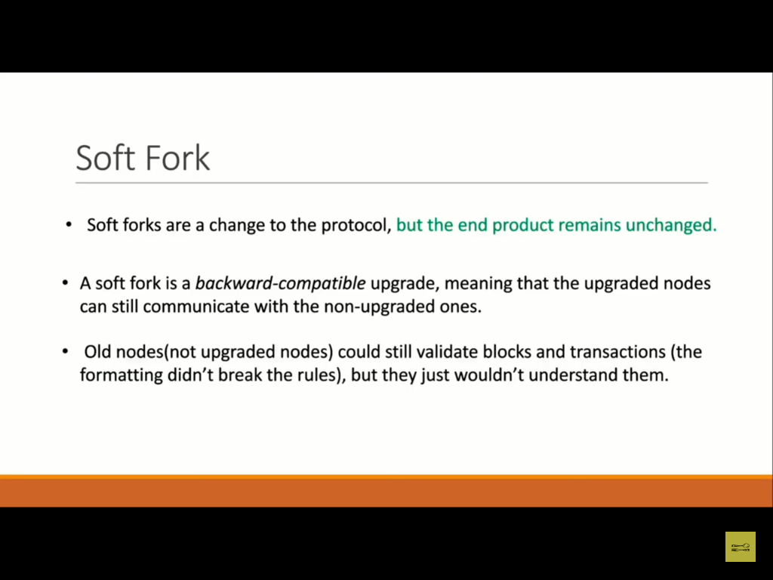

Slide 10
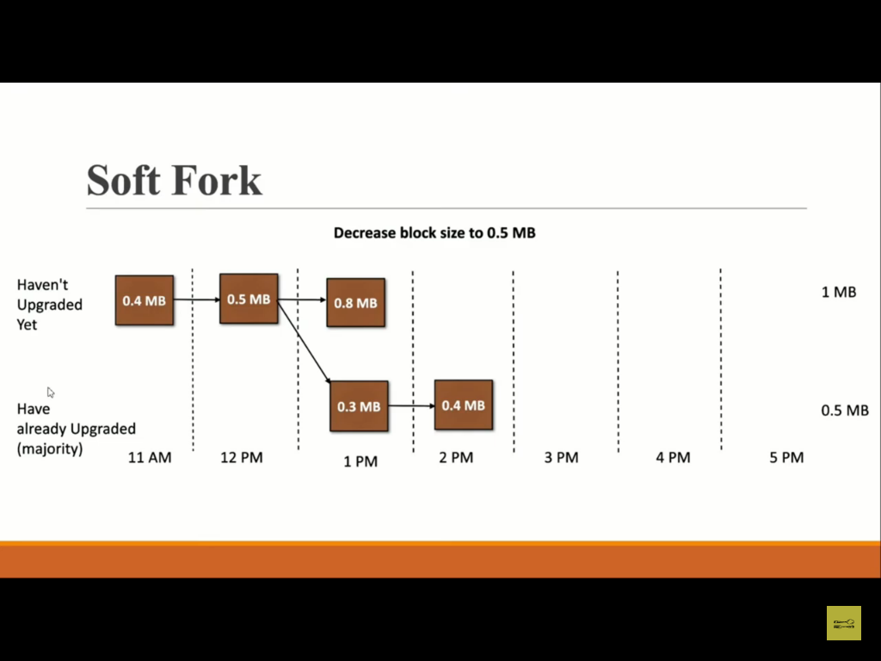

Slide 11
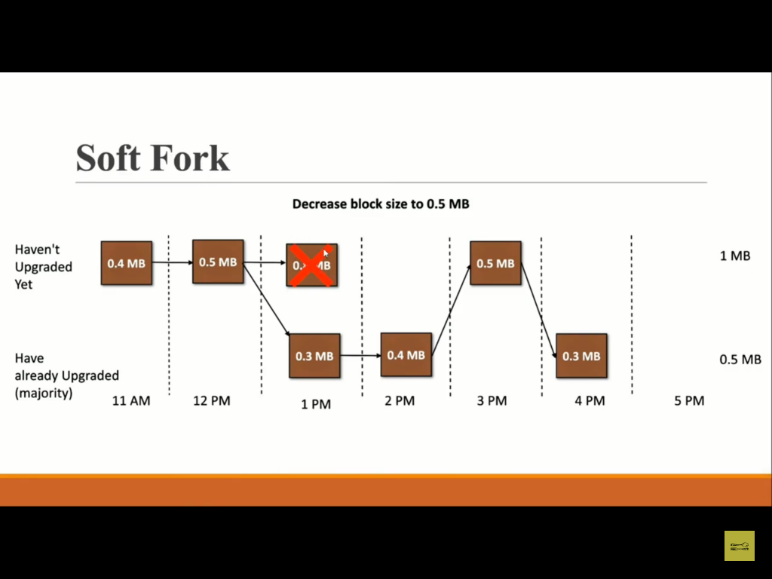

Slide 12


Slide 13
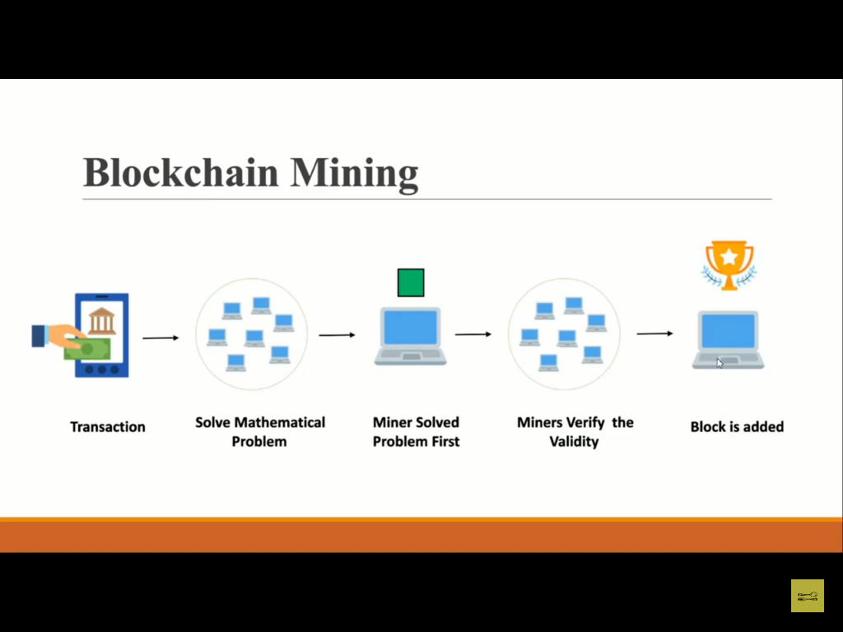

Slide 14
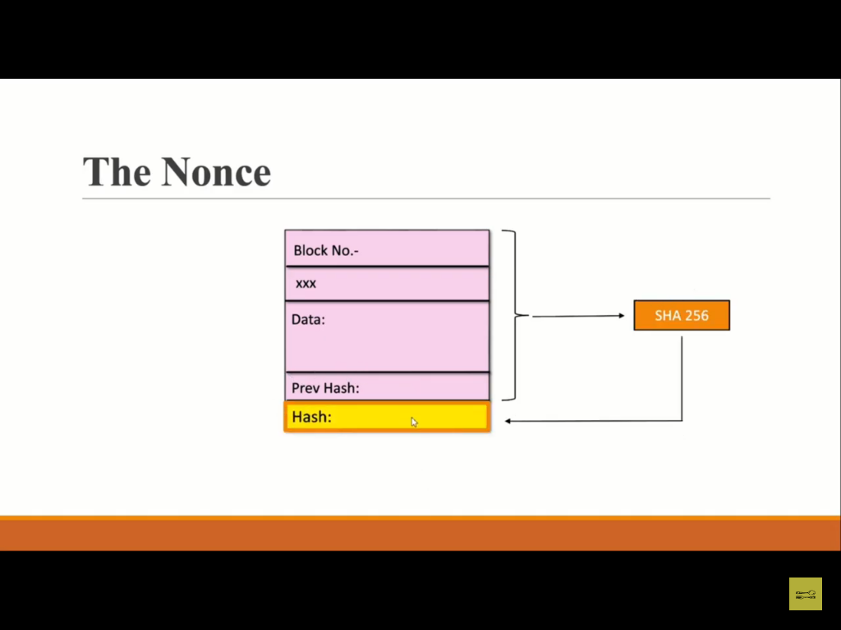

Slide 15


Slide 16
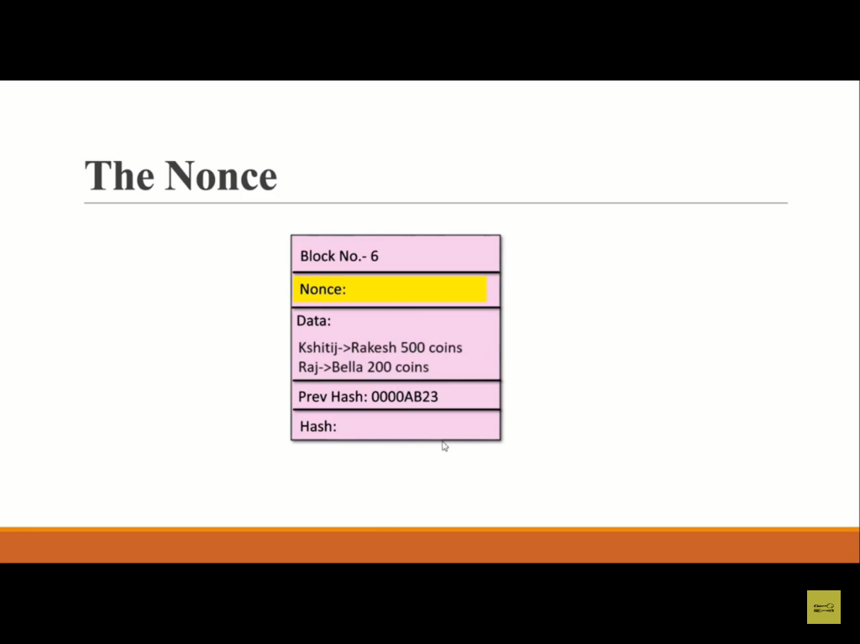

Slide 17
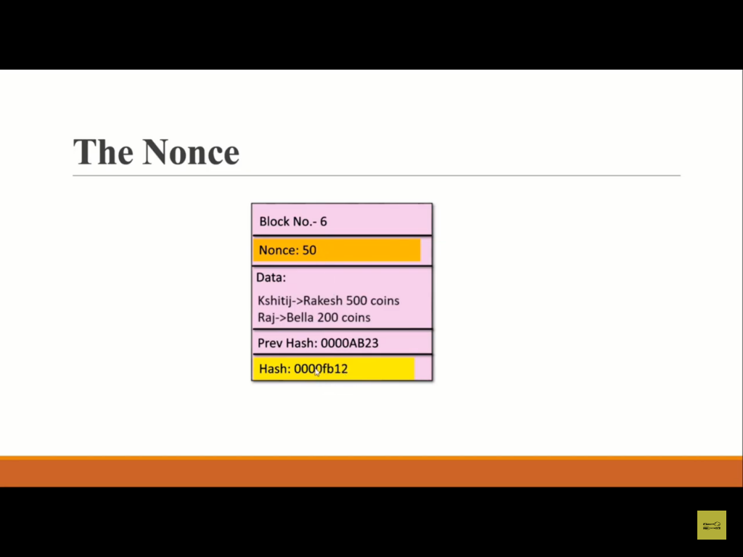

Slide 18
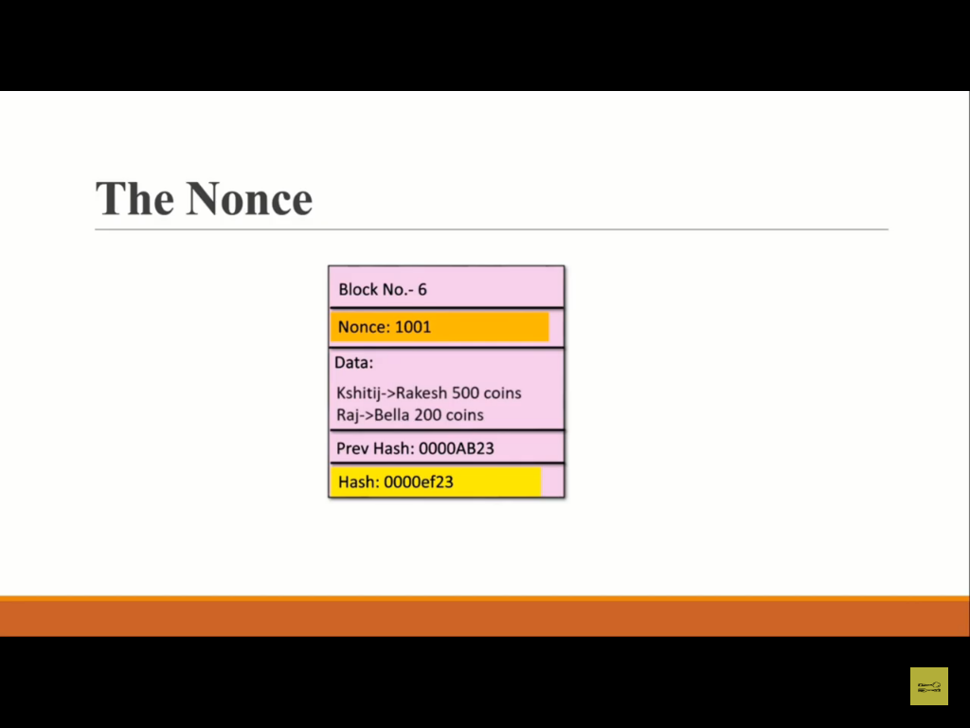

Slide 19
https://demoblockchain.org/block

Slide 20
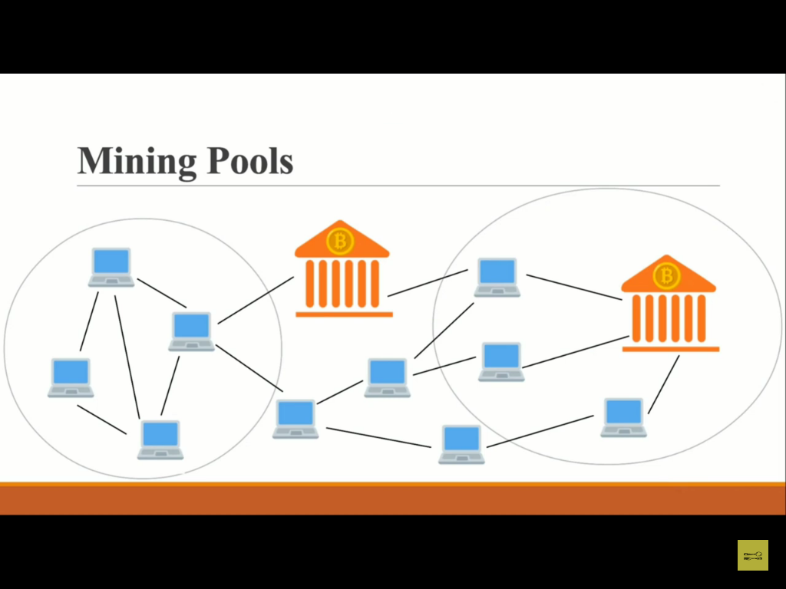

Slide 21
https://www.blockchain.com/charts/pools

Slide 22
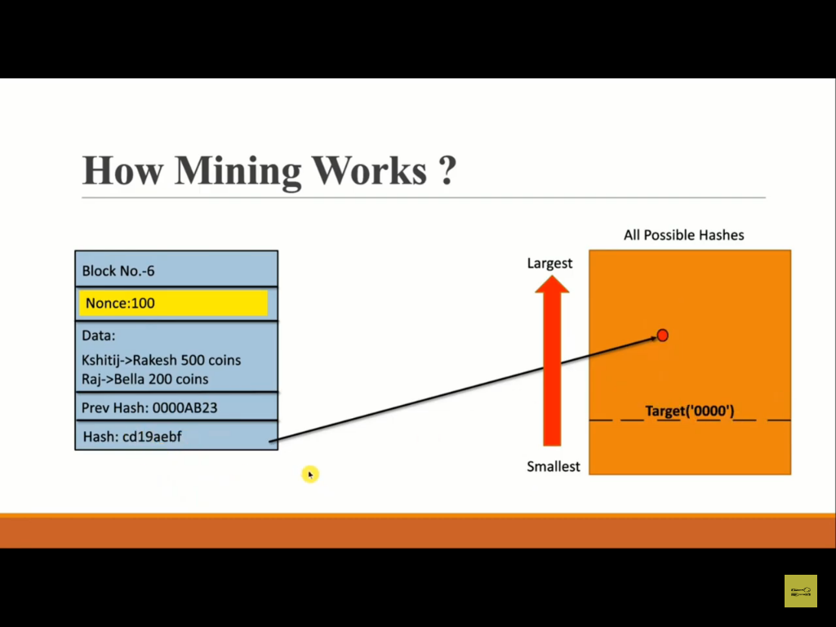

Slide 23


Slide 24


Slide 25


Slide 26


Slide 27
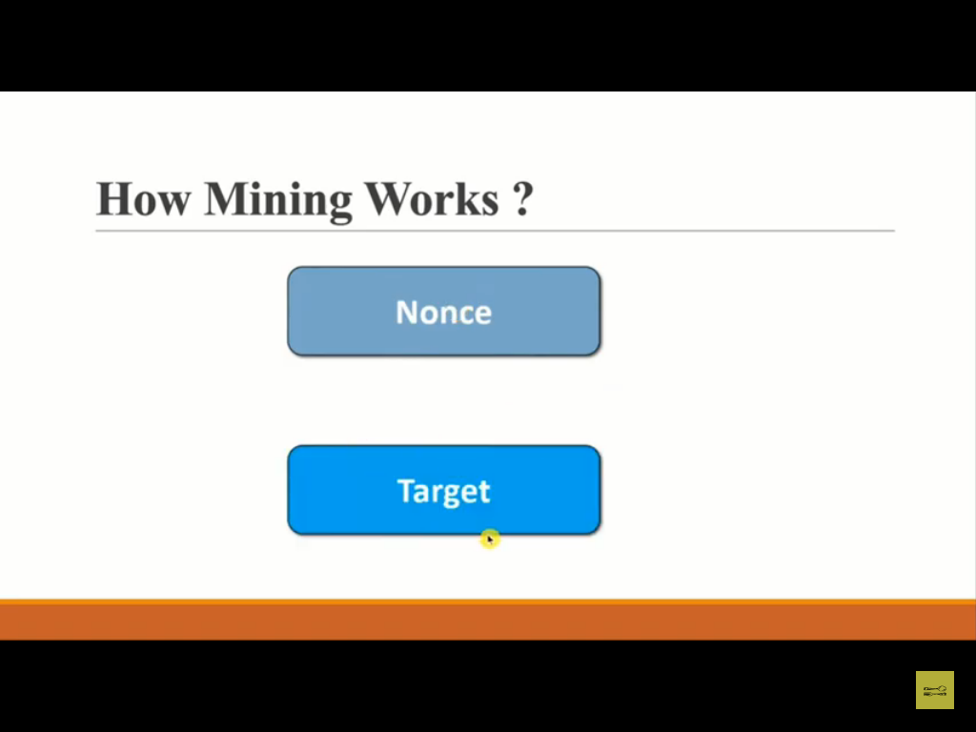

Slide 28
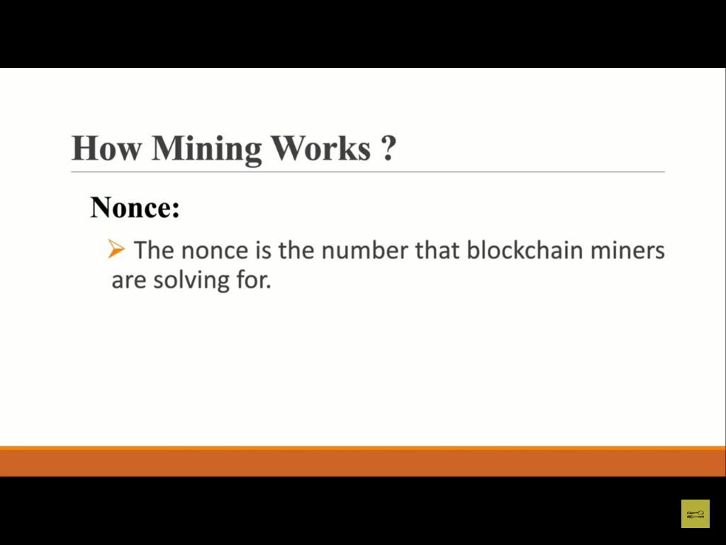

Slide 29
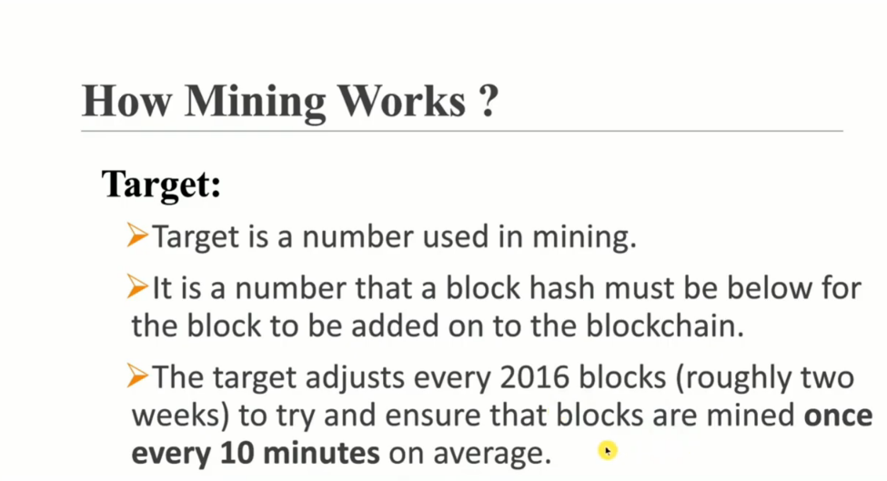

Slide 30
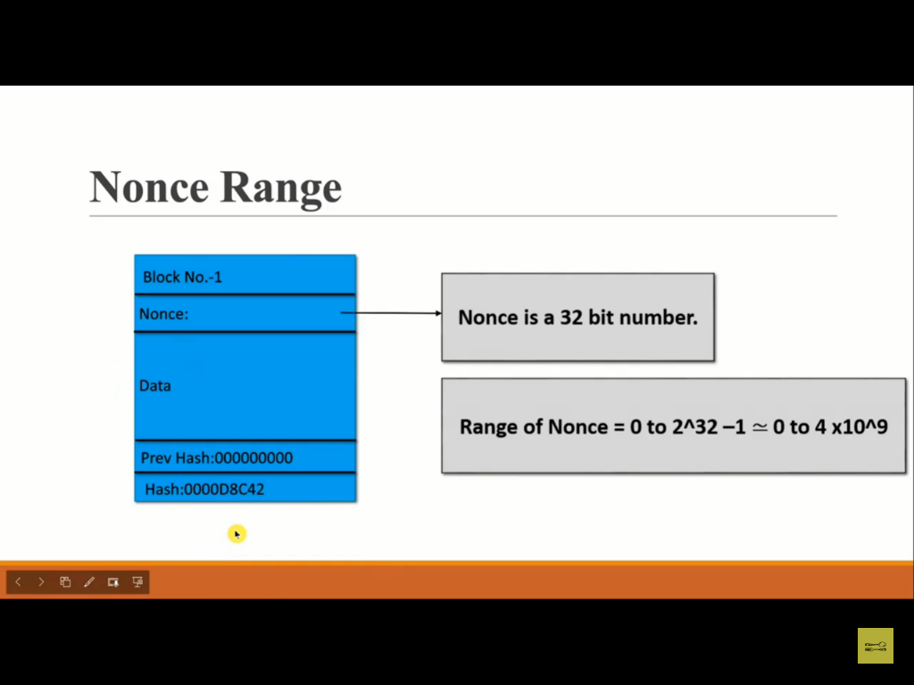

Slide 31
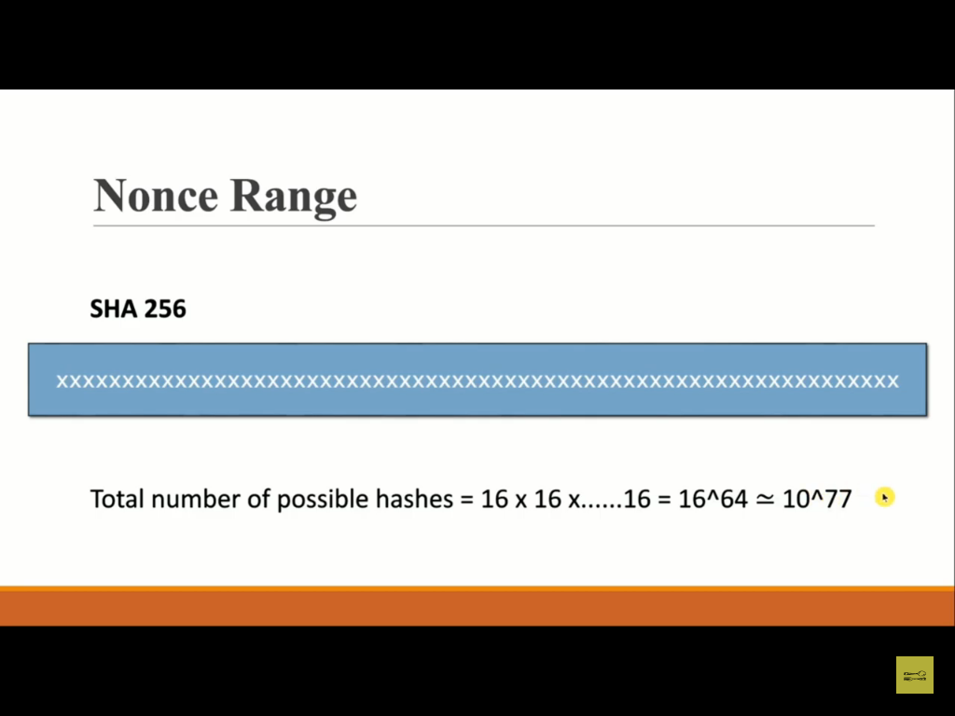

Slide 32
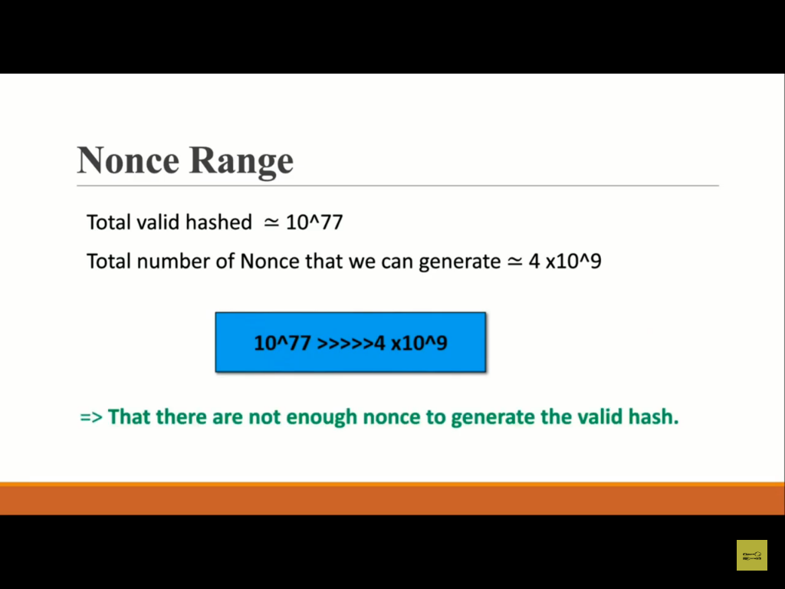

Slide 33
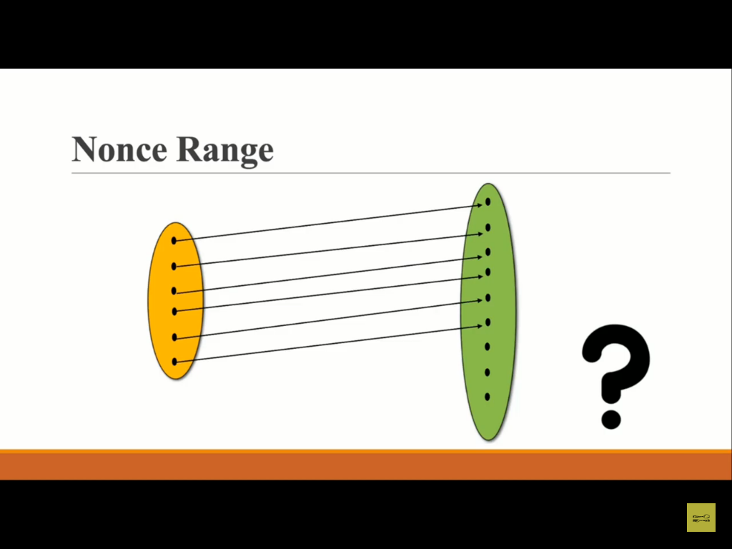

Slide 34
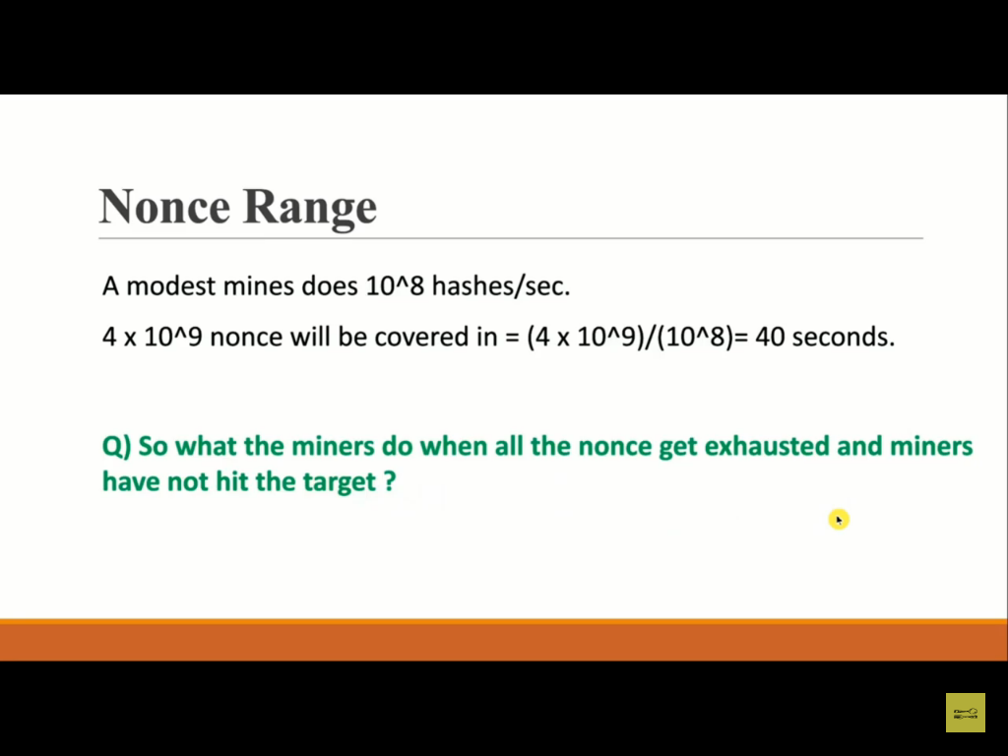

Slide 35
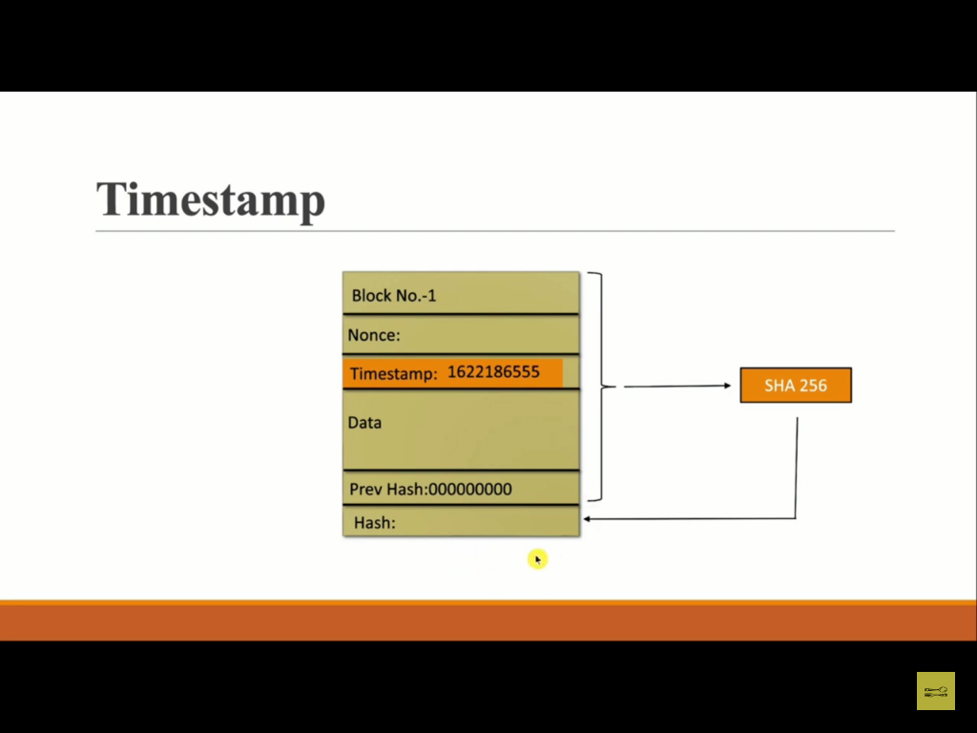

Slide 36
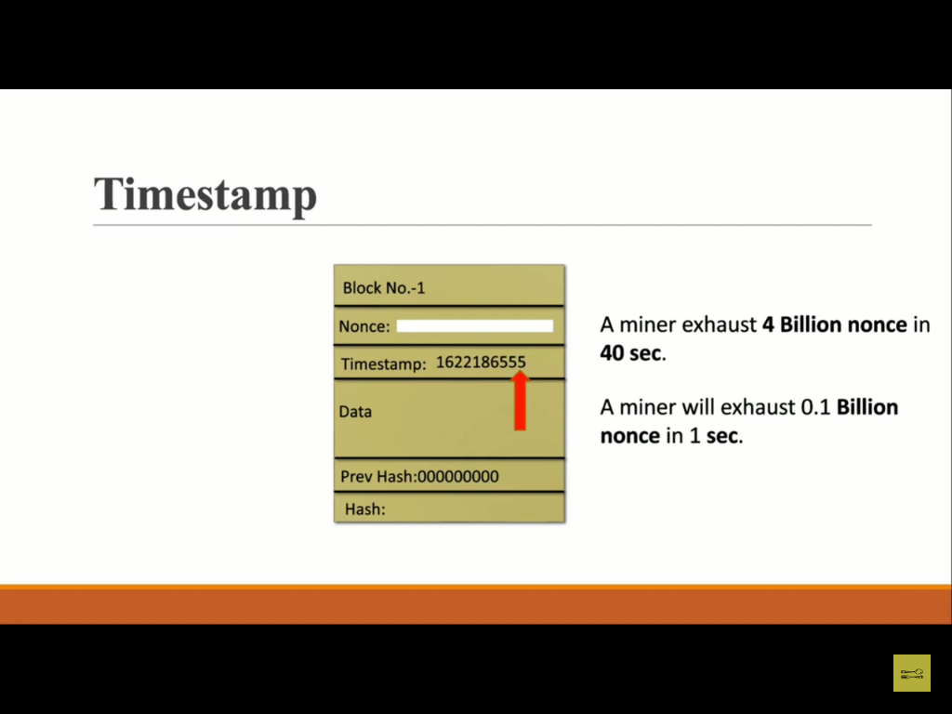

Slide 37
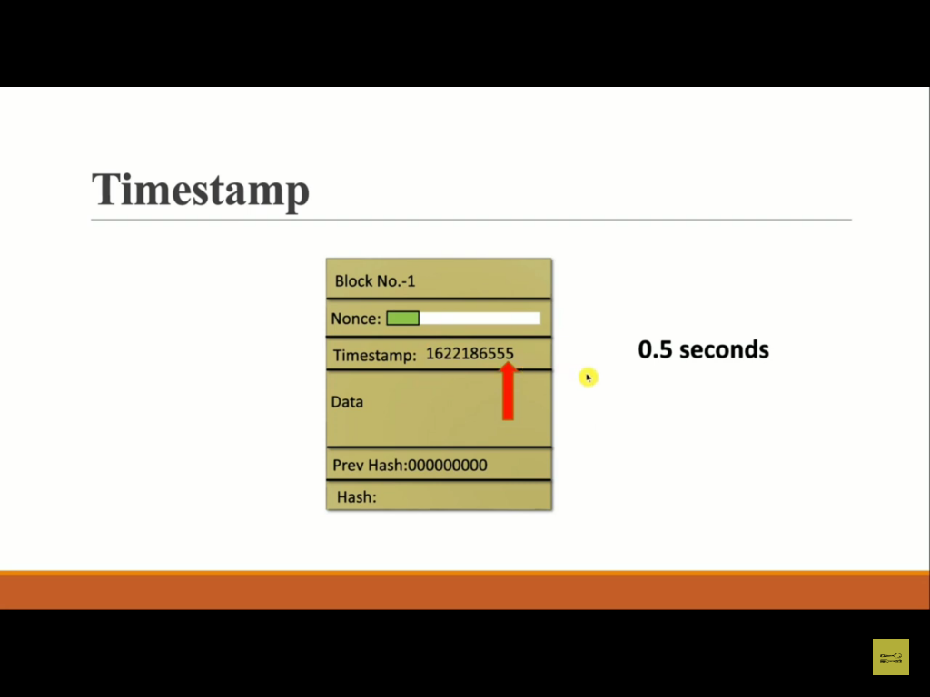

Slide 38
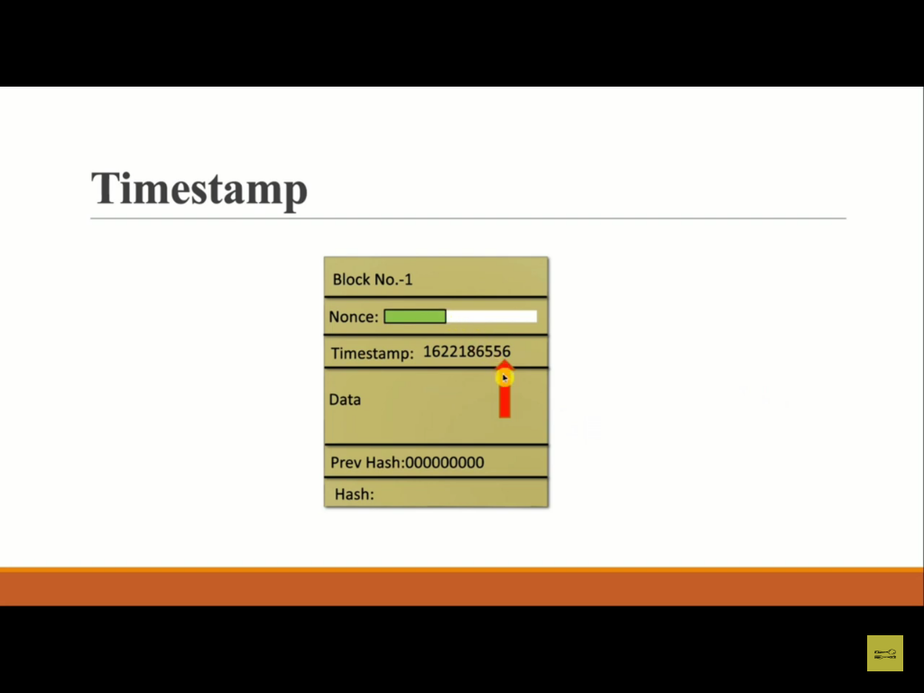

Slide 39


Slide 40


Slide 41
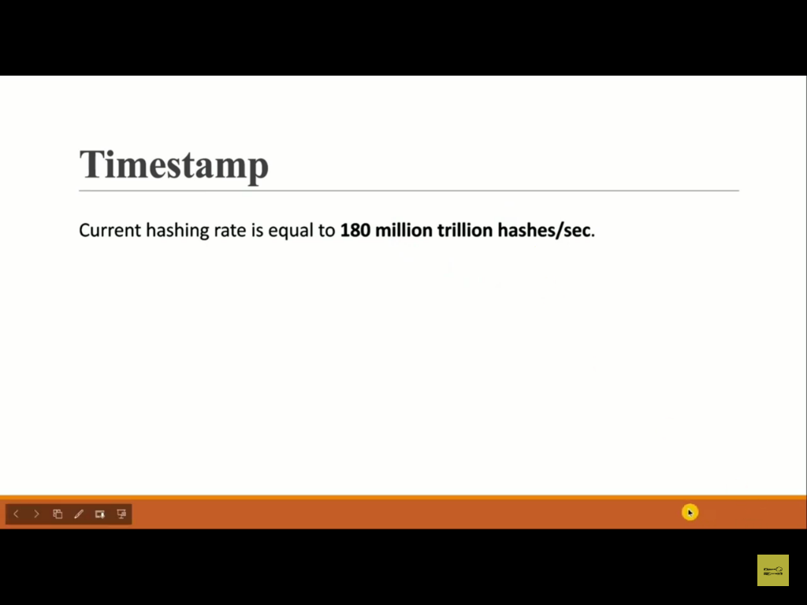

Slide 42
https://www.blockchain.com/charts

Slide 43
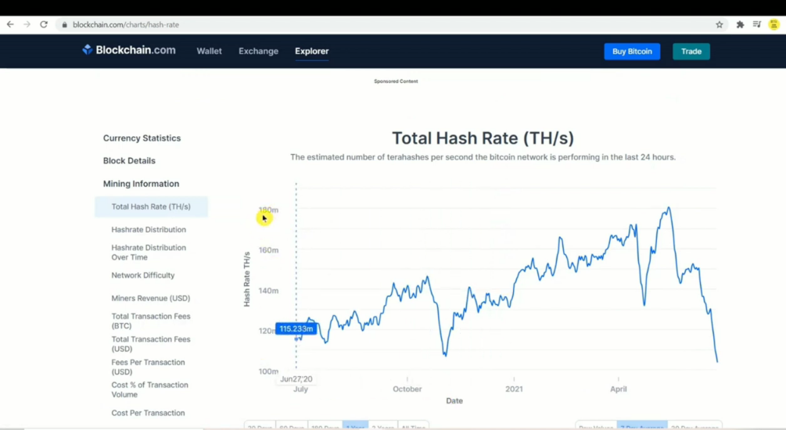

Slide 44
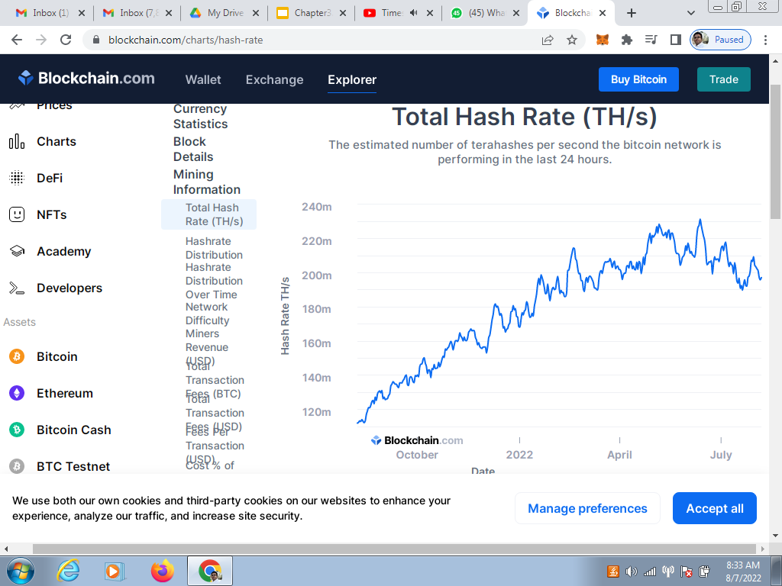

Slide 45
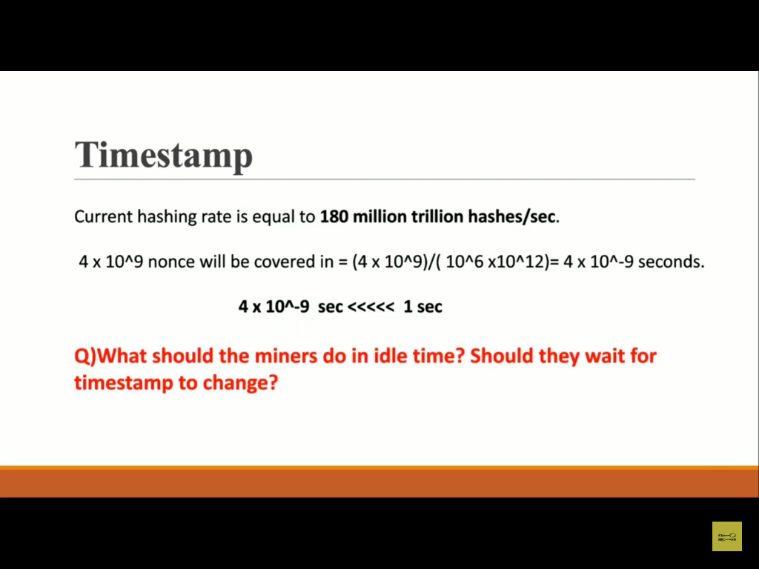

Slide 46
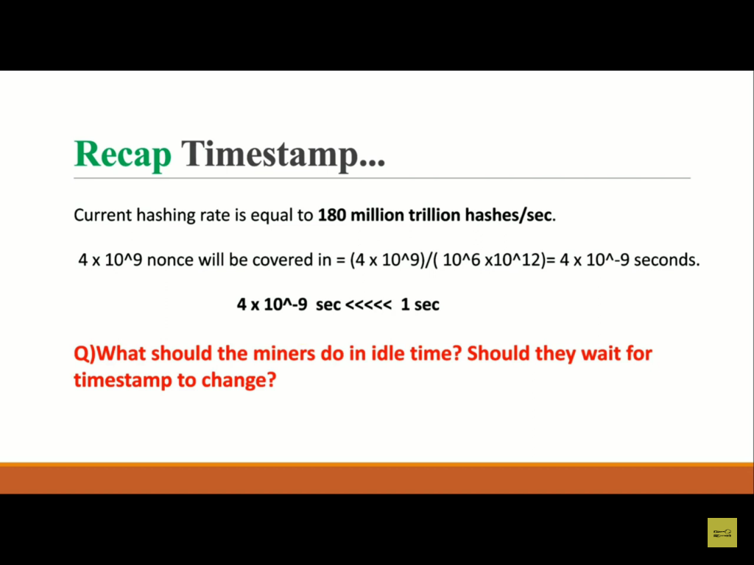

Slide 47
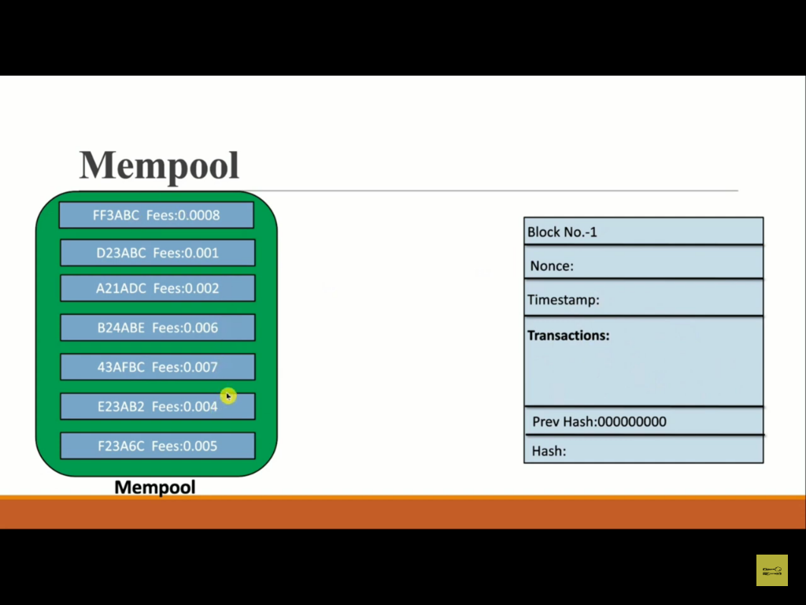

Slide 48
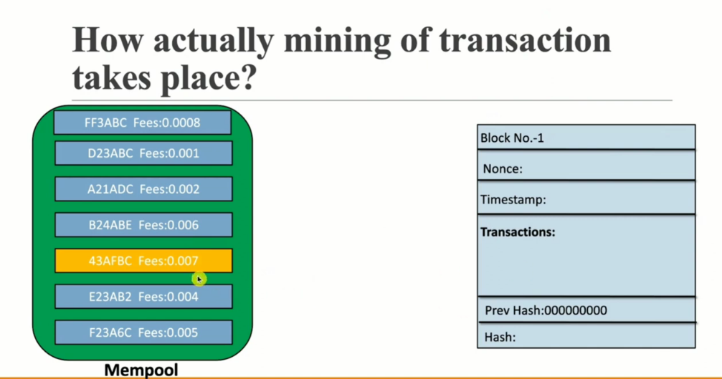

Slide 49
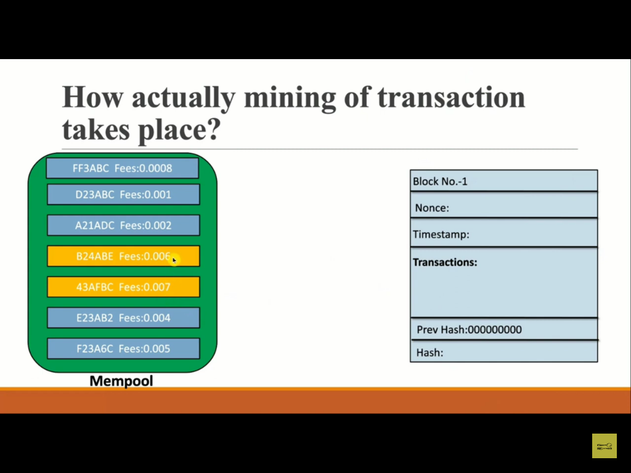

Slide 50
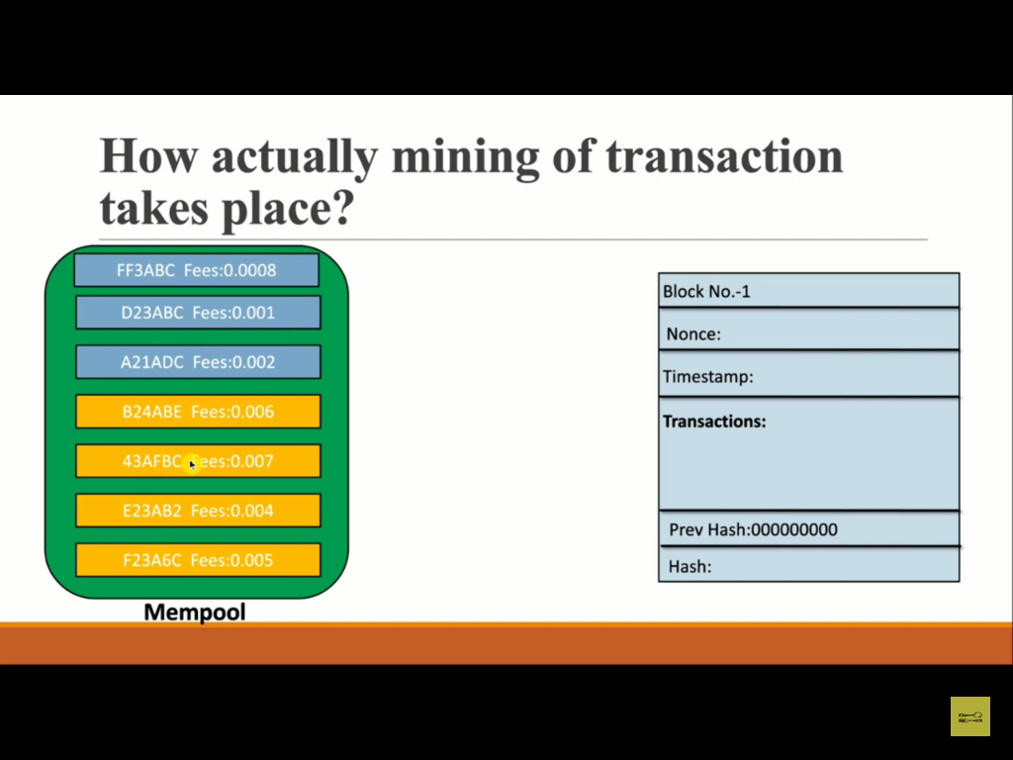

Slide 51
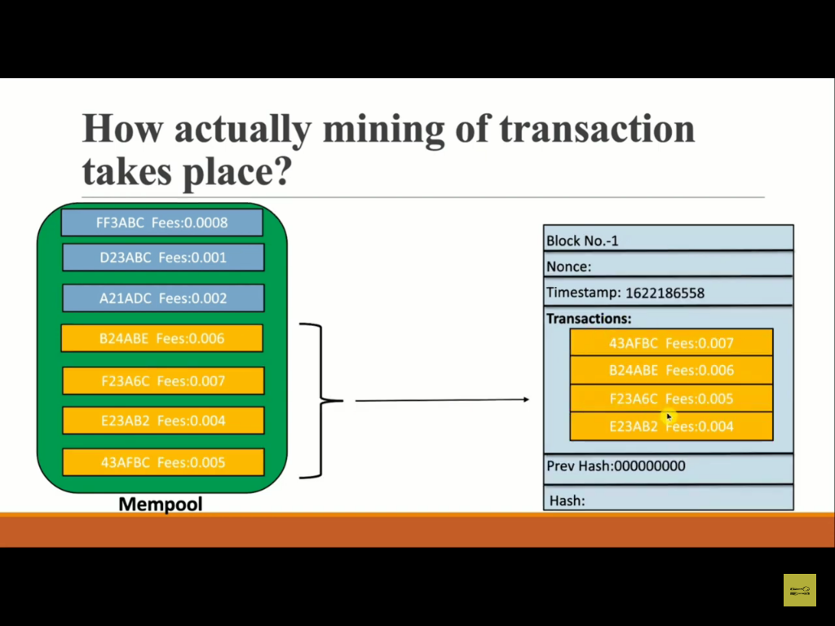

Slide 52
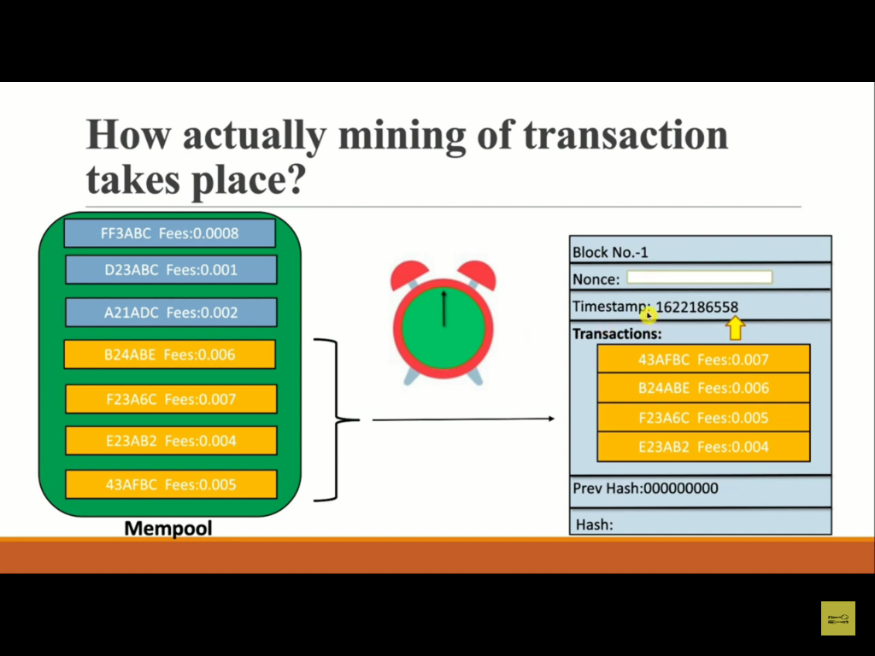

Slide 53
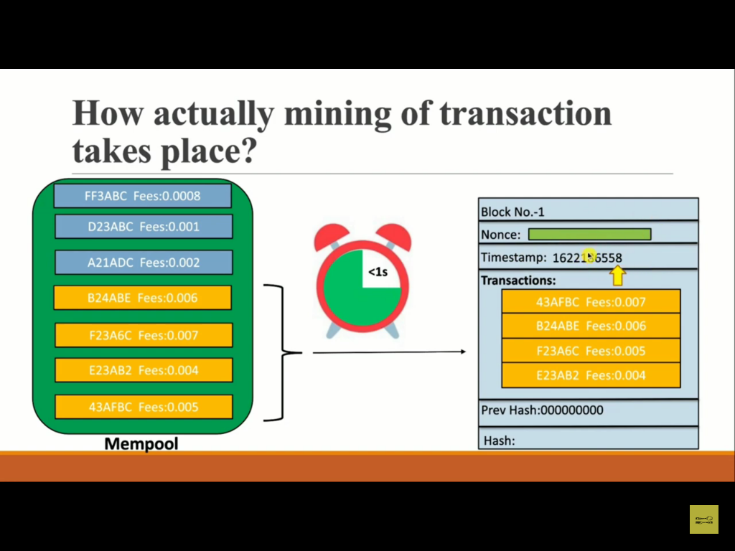

Slide 54
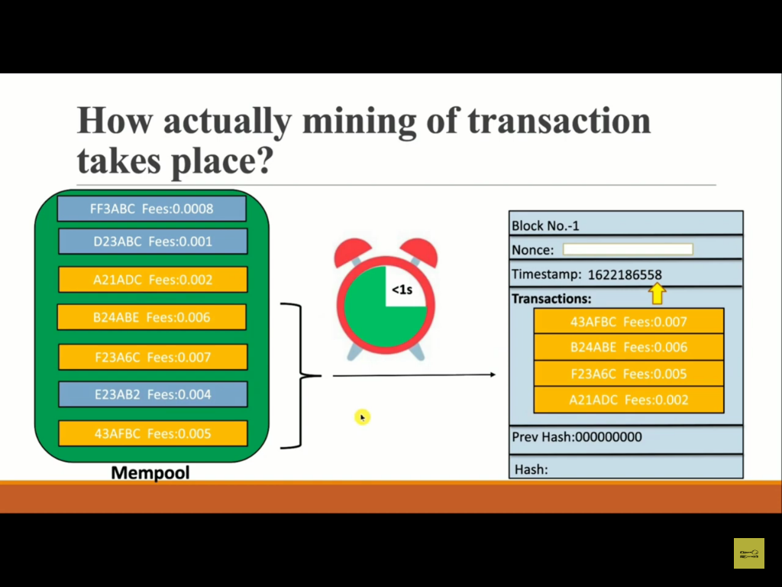

Slide 55
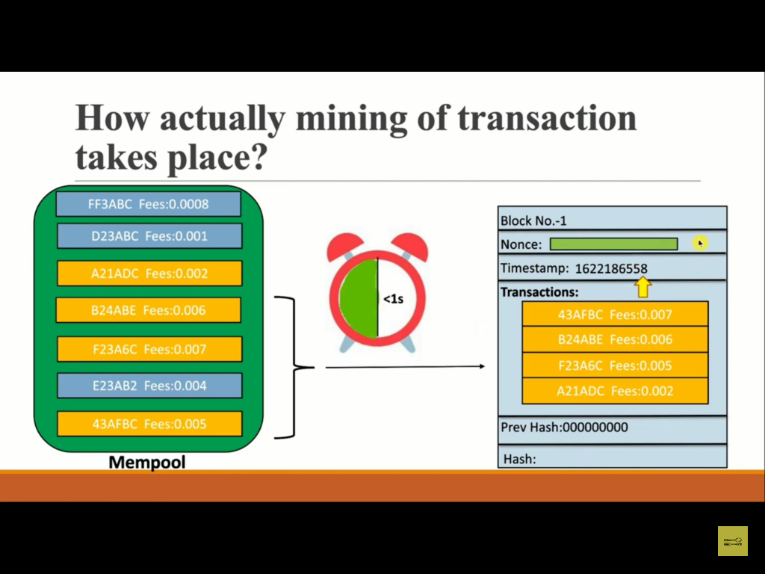

Slide 56
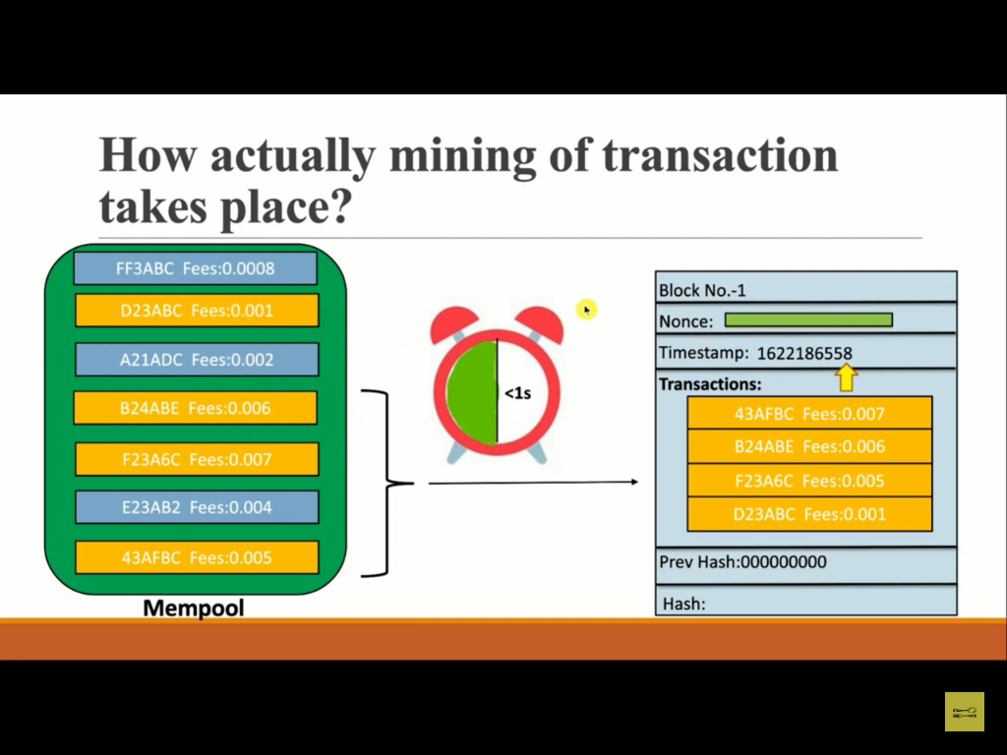

Slide 57
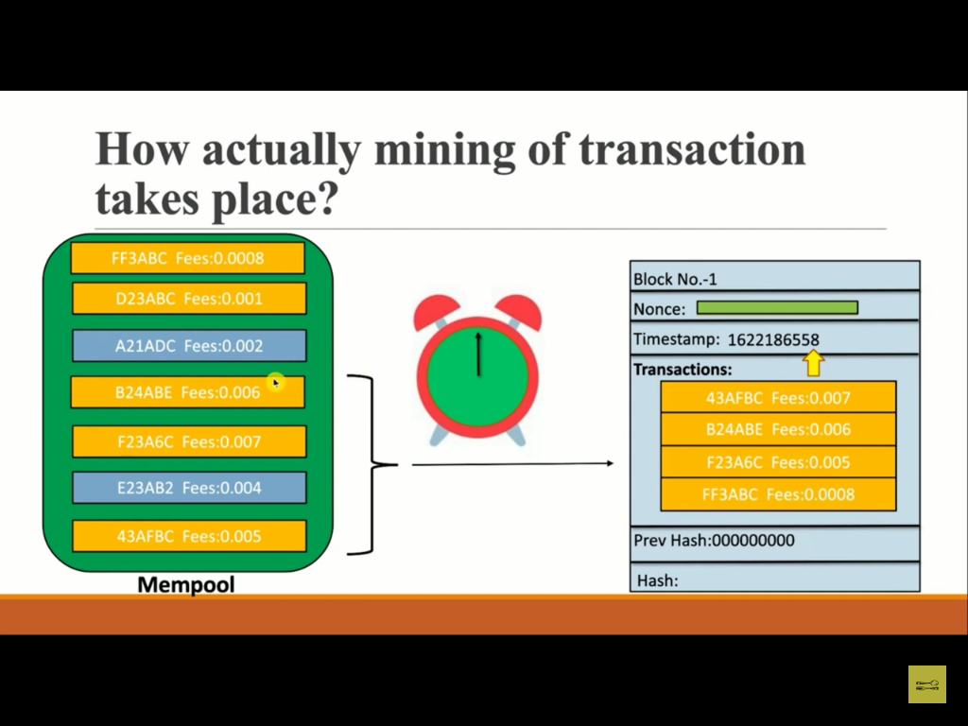

Slide 58
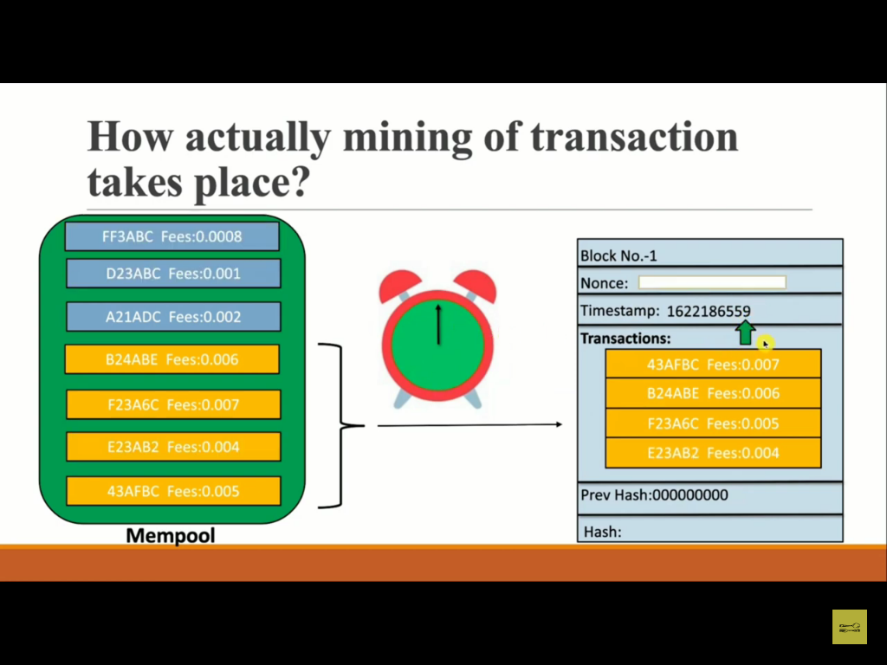

Slide 59
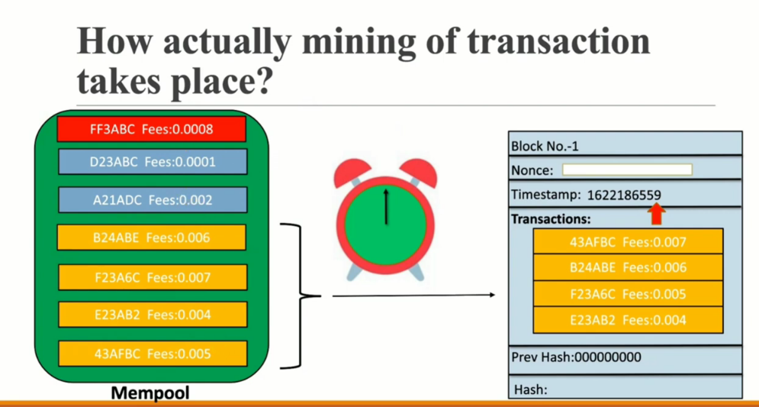

Slide 60
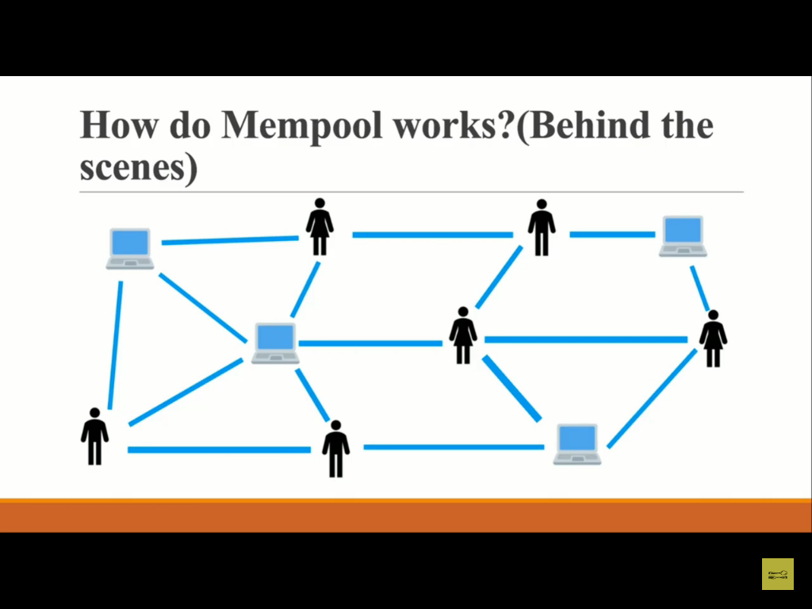

Slide 61
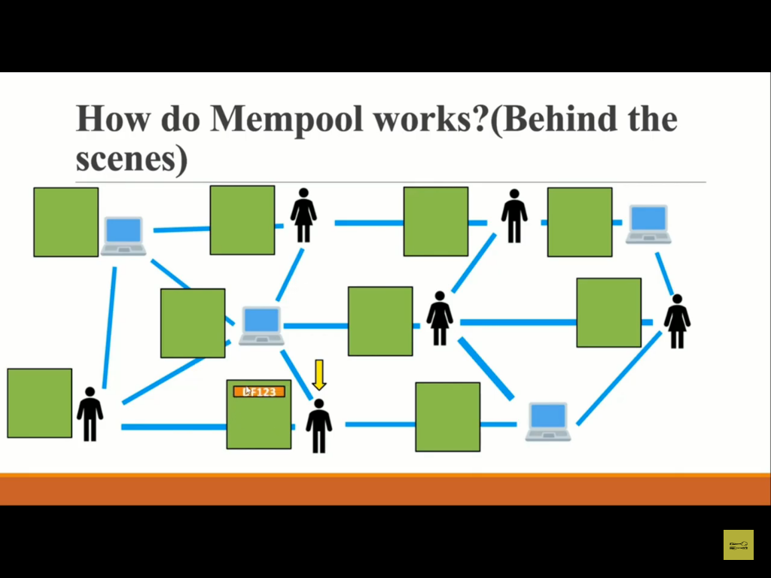

Slide 62
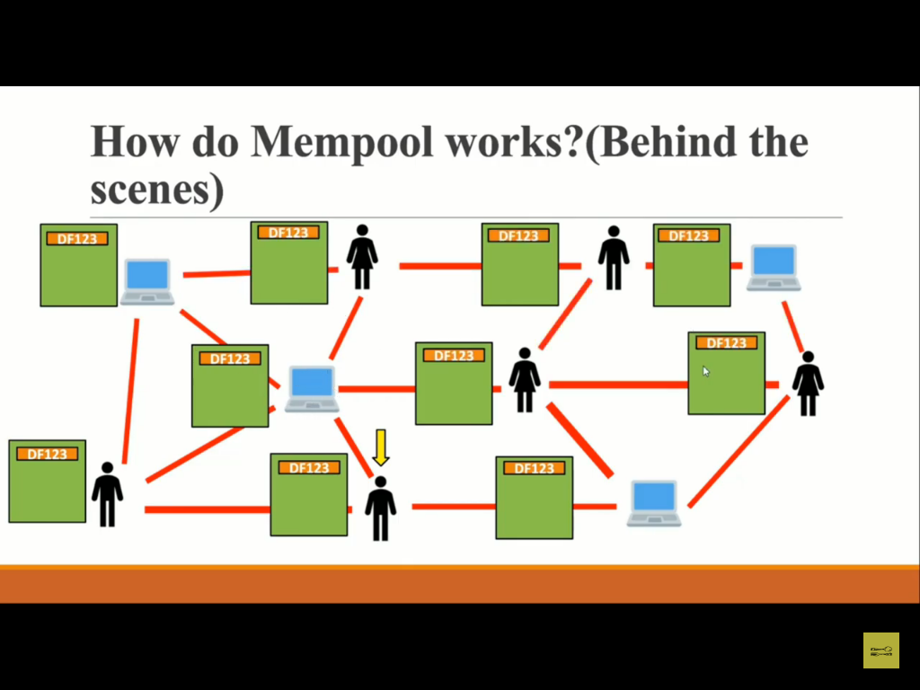

Slide 63
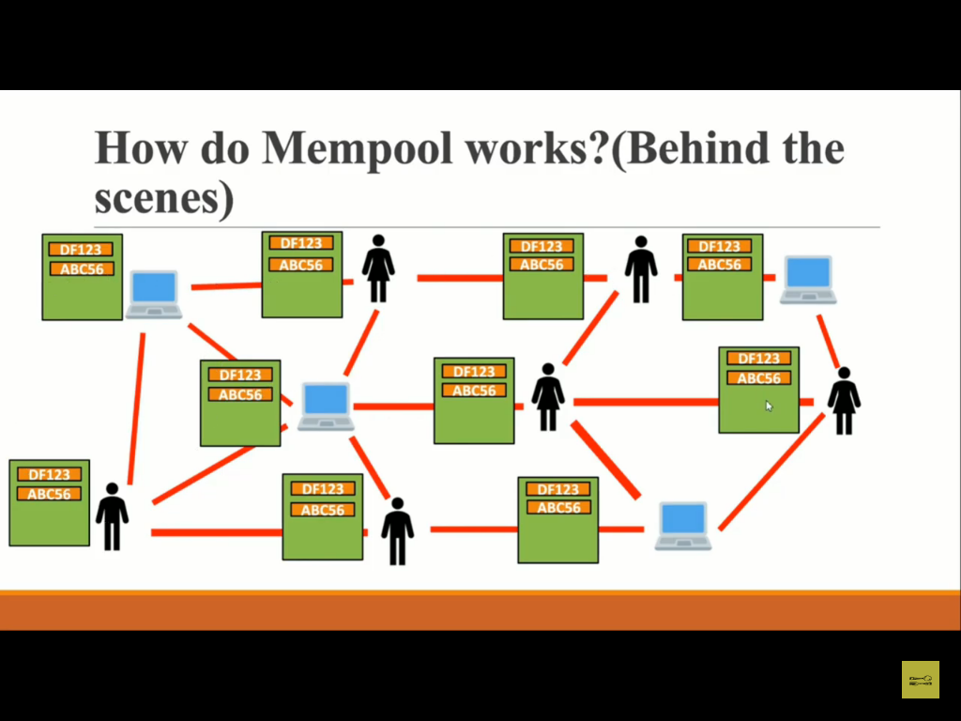

Slide 64
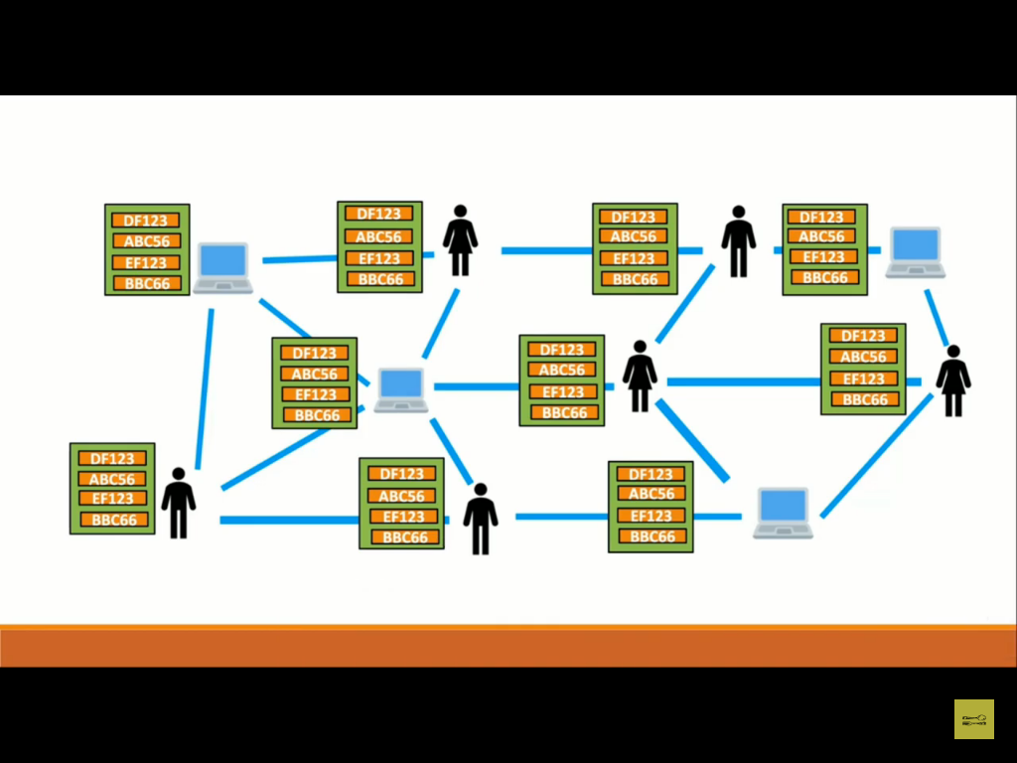

Slide 65
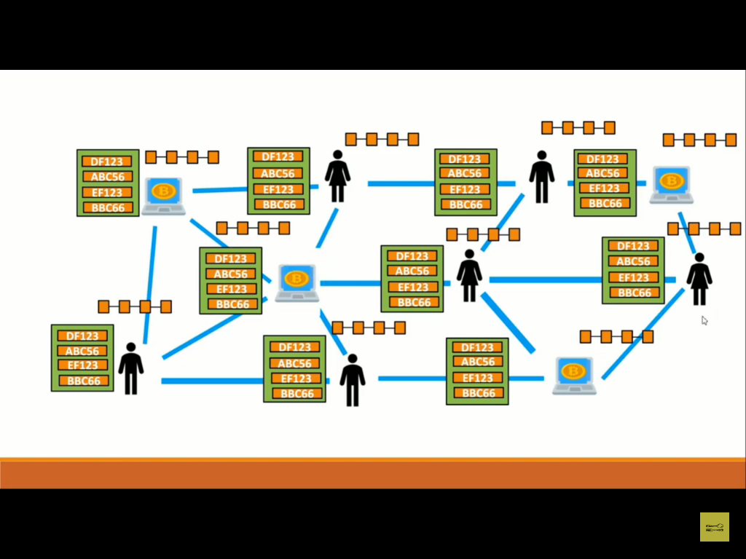

Slide 66
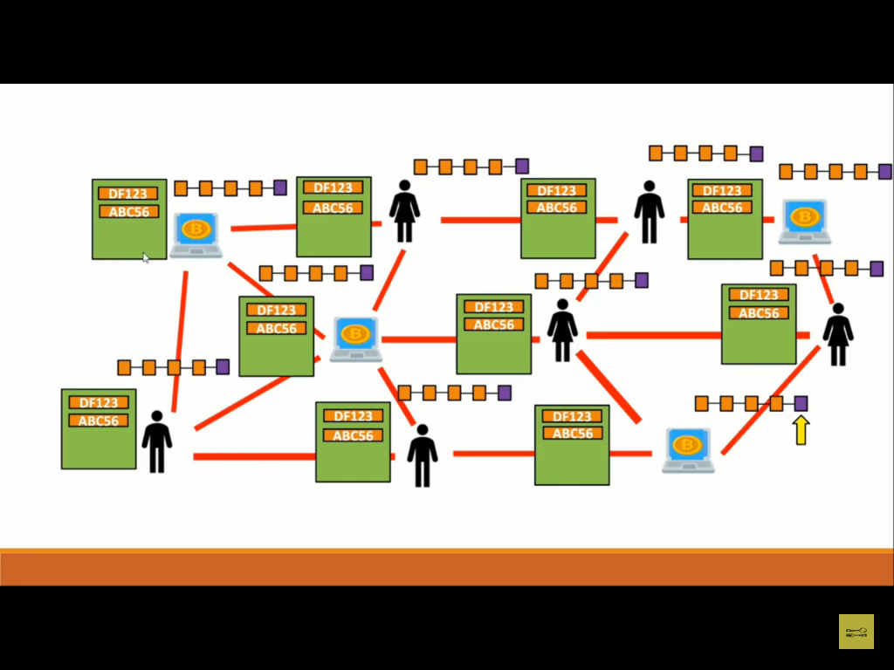

Slide 67
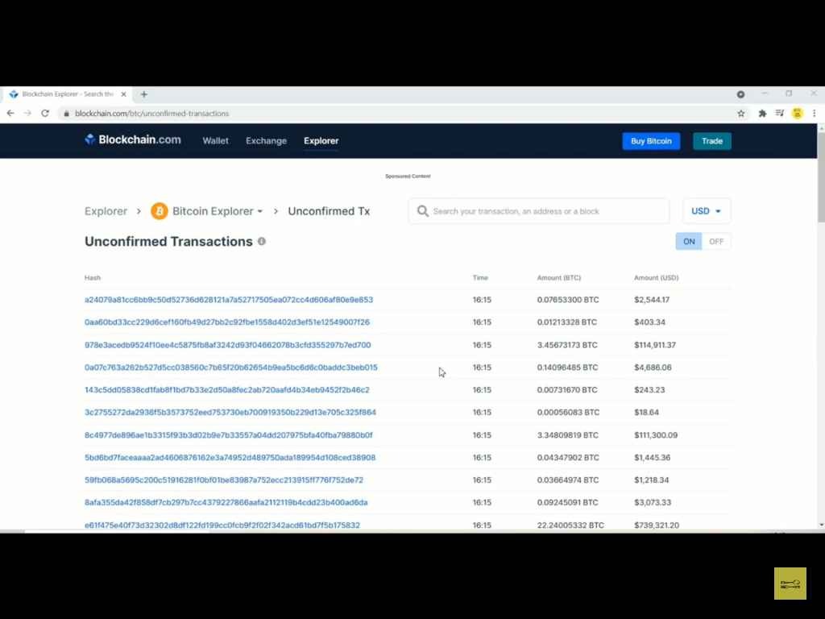

Slide 68
https://www.blockchain.com/btc/unconfirmed-transactions?show_adv=true

Slide 69
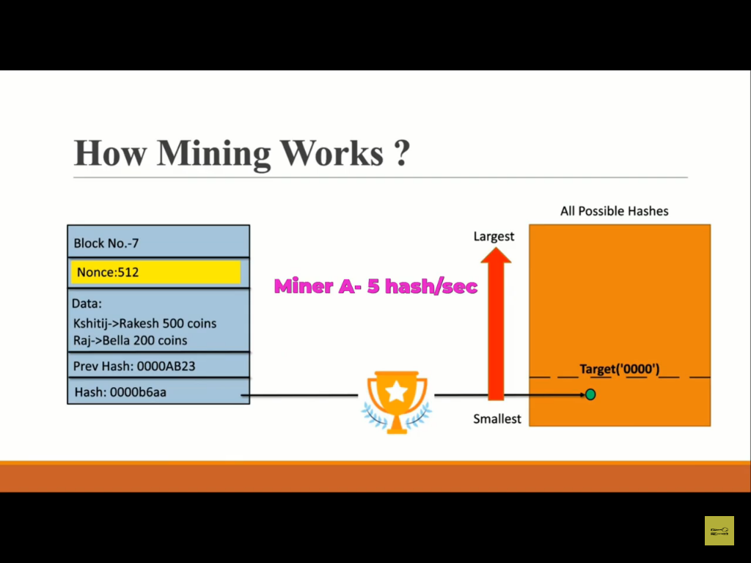

Slide 70


Slide 71
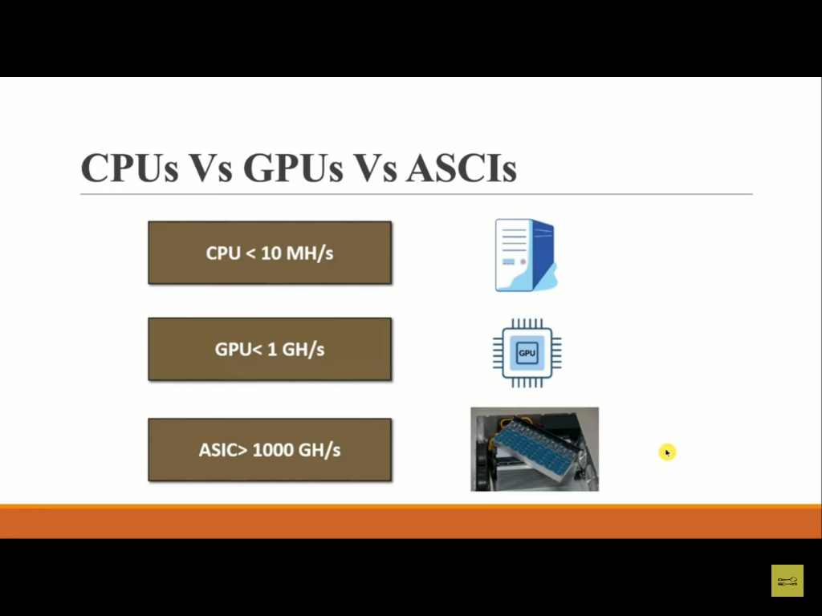

Slide 72


Slide 73


Slide 74


Slide 75


Slide 76


Slide 77


Slide 78


Slide 79


Slide 80


Slide 81


Slide 82


Slide 83


Slide 84


Slide 85


Slide 86


Slide 87


Slide 88


Slide 89
https://tools.superdatascience.com/blockchain/public-private-keys/keys

Slide 90


Slide 91


Slide 92


Slide 93


Slide 94
what is Proof of burn ?
Proof of burn is one of the several consensus mechanism algorithms implemented by a blockchain network to ensure that all participating nodes come to an agreement about the true and valid state of the blockchain network. This algorithm is implemented to avoid the possibility of any cryptocurrency coin double-spending.

Slide 95
Proof of burn (POB) is an alternative consensus algorithm that tries to address the high energy consumption issue of a POW system.
POB is often called a POW system without energy waste. It operates on the principle of allowing miners to “burn” virtual currency tokens. They are then granted the right to write blocks in proportion to the coins burnt.
Iain Stewart, the inventor of the POB algorithm, uses an analogy to describe the algorithm: burnt coins are like mining rigs. In this analogy, a miner burns their coins to buy a virtual mining rig that gives them the power to mine blocks. The more coins burned by the miner, the bigger their virtual mining "rig" will be.

Slide 96
To burn the coins, miners send them to a verifiably un-spendable address. This process does not consume many resources (other than the burned coins) and ensures that the network remains active and agile. Depending upon the implementation, miners are allowed to burn the native currency or the currency of an alternate chain, such as Bitcoin. In exchange, they receive a reward in the native currency token of the blockchain.
You can send out transactions to the network that will burn your own cryptocurrency coins. Other participants can mine/burn on top of your block, and you can also take the transactions of other participants to add them to your block. Essentially, all of this burning activity keeps the network agile, and participants are rewarded for their activities (both burning their own coins and burning other people’s coins).

Slide 97
To prevent the possibility of unfair advantages for early adopters, the POB system has implemented a mechanism that promotes the periodic burning of cryptocurrency coins to maintain mining power.
The power of burnt coins “decays” or reduces partially each time a new block is mined. This promotes regular activity by the miners, instead of a one-time, early investment. To maintain a competitive edge, miners may also need to periodically invest in better equipment as technology advances.

Slide 98
Example of Proof of Burn
POB implementation can be customized. For example, Slimcoin, a virtual currency network that uses POB, allows a miner to burn coins that not only gives them the right to compete for the next block but also gives them the chance to receive blocks during a longer time period, for at least a year.
Essentially, Slimcoin’s POB implementation combines three algorithms: POW, POS, and the core POB concept.
The process of burning coins utilizes POW; the more coins one burns the more chances one has to mine, thus ensuring POS; and the whole ecosystem follows the POB concept.

Slide 99


Slide 100


Slide 101


Slide 102


Slide 103


Slide 104


Slide 105
https://www.investopedia.com/terms/a/altcoin.asp

Slide 106


Slide 107


Slide 108


Slide 109


Slide 110


Slide 111


Slide 112


Slide 113


Slide 114


Slide 116
Characteristics of Crypto Currency
Decentralized
Form of existence
Limited supply
Global Access
Anonymity & transparency
Impossible to duplicate
Irreversible

Slide 117
Cryptocurrency Wallets
Bitcoin or any other cryptocurrency transaction can be done only using a digital wallet. A digital wallet or cryptocurrency wallet is a software program that stores the user’s private and public keys enabling the user to transact crypto assets.
It is a management system that interacts with various blockchains to enable users to send and receive digital currency and monitor their balance.
Cryptocurrencies are stored immutably on the blockchain using your public key, i.e., your public key is used by other wallets to send funds to your wallet’s address. However, the private key is required if you want to spend cryptocurrency from your address.

Slide 118
Types of Wallets
A cold wallet is a digital wallet that is not connected to the internet. They are not free. Being offline, they are more secure and used for storing cryptocurrencies long term.
A hot wallet is designed for online day-to-day transactions. It is always connected to the internet and hence it is a strong candidate for hackers.
CRYPTOCURRENCY WALLETS
HOT WALLETS
COLD WALLETS
ONLINE/WEB WALLET
SOFTWARE WALLET
PAPER WALLET
HARDWARE WALLET
E.g. MyEtherWallet
E.g. Ledger, Trezor
MOBILE WALLET
DESKTOP WALLET
E.g. Coinomi, Mycelium
E.g. Electrum, Armory

Slide 119


Cryptocurrency Types
CRYPTOCURRENCY TYPES
T
Utility Token
Security Token
BITCOIN
ALTCOIN
TOKEN
DERIVED FROM BITCOIN
DERIVED FROM ORIGINAL BLOCKCHAIN
E.g. Litecoin, Dogecoin
E.g. Ether, NXT

Slide 120
Cryptocurrency Eco-system Players
Programmers/Developers: Miners
Users
Merchants
Traders

Slide 121
Crypto Mining
Miners generate wealth through mining. A miner needs to have some level of technical knowledge and expertise in setting up computing software and equipment. Blockchains vary in the mining systems that they use. However, they all have some form of a consensus algorithm and an incentive system.
There are two types of miners: those who go solo called solo miners and those who collaborate with others, referred to as pool miners.
There are different types of mining based on the processors or equipment used by the miner:
CPU Mining
GPU Mining
ASIC Mining
Cloud Mining

Slide 122
Airdrop
Airdrop is a promotional activity aimed at spreading awareness among the blockchain community. It is a distribution event where a blockchain project distributes free coins or tokens to wallet addresses to create a market for the project and create a buzz among investors.
The various benefits of airdrops to the blockchain enterprise are:
Marketing and Hype
Rewarding Loyalty Supporters and Investors
Wider and Even Distribution of Tokens
Lead Database Generation
Cryptocurrency airdrops are done in two ways – a surprise airdrop or a planned airdrop.

Slide 123
Coin Burning
Token or Coin Burning is a process of permanently removing coins out of circulation to reduce the total supply. The coin is considered to be burned when it is sent to an unspendable public address, known as an eater address, which does not have an operable private key associated with it.
The key purpose of burning coins:
To Reward Investors
To destroy unsold ICO tokens
To decentralize mining opportunity (Proof-of-Burn)

Slide 124
Cryptocurrency Safety
Best practice in using Exchanges
Choose regulated exchanges that have safety and security measures in place. Binance, Bittrex, and Coinbase are popular crypto exchanges.
Storing Cryptocurrency
Store your crypto in desktop or mobile wallets if short-term and in paper and hardware wallets if long-term.
Use wallets from reputable sources.
Transaction Safety
Study the transaction requirements of a cryptocurrency carefully as they may indicate the security precautions to be taken.
Enable Security Measures
Protect wallets and backups with strong passwords.

Slide 125

Cryptocurrency Regulations

